Slide 2
This stage in an illness is when sickness starts to affect the person
in observable ways. Temperature may rise. A cough might present
itself. The individual might become weak and queasy.
What would this stage be like in a revolution?
In a revolution, this stage would be the first to involve direct
action resulting from the social, political, intellectual, or economic
causes of the incubation stage. This stage might involve the publication
of works calling for a change, street level riots by the common people,
or more direct attempts at changing the society.
Notes:
Symptomatic Phase
Stamp act
Sugar Act
Declaratory Acts
Intolerable Acts
Boston Tea Party
Boston Massacre
First Continental Congress

Slide 3
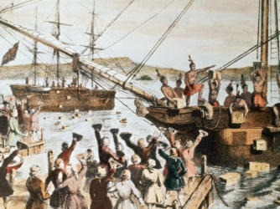
Stage 2: Symptomatic
Sugar Act
Stamp act
  Declaratory Acts
Townshend Acts
Boston Massacre
Boston Tea Party
  Intolerable Acts
First Continental Congress
Notes:
Sugar Act of 1764—established a precedent but not mass protest because most colonists were unaffected
Stamp Act of 1765—established a tax on common paper goods like marriage licenses & property deeds:
mass protest by common citizens—riots, boycott, Sons of Liberty, & women’s role
The Massachusetts Stamp Act Congress called for Parliament to repeal the tax
SA Repealed in 1766 but replaced with the Declaratory Act (“Parliament is sovereign in all cases whatsoever”)
The Townshend Acts (1767) were created to avoid the mistakes of the Grenville taxes:
Indirect taxes on paper, lead, glass, and tea & created an American Board of Customs Commissioners
The Sons of Liberty issued a circular letter to all the colonies to protest the Townshend Acts
Many in British Parliament believed this tax would be viewed as acceptable by colonist. Ben Franklin had told British
the Colonists were fine with EXTERNAL TAXES (Goods coming into colonies), just not INTERNAL TAXES (tax on items
in colonies).
* Colonists view: A Tax is a Tax
* Franklin misrepresented the colonists.
Boston Massacre:
1)Heightened tensions between Bostonians and British troops stationed there over two incidents:
* Shooting death of an 11 year-old boy by a customs officer.
* British troops in Boston were competing for jobs with colonists.
2) March 5, 1770 – Angry mob confronts a group of British soldiers at a custom officials house. Without orders the British opened fire killing 5 instantly and wounding 6 others. (2 of those individuals would die as well.)
Boston Tea Party:
1) Colonists dressed up as Native Americans dumped 45 tons of East India tea into Boston Harbor.
* Other instances of Tea Party’s took place but Britain
focused their attention on Boston and the troublesome
colony of Massachusetts.
What was Britain’s response to the Tea Party?
Coercive (Intolerable) Acts (Spring 1774) – A series of acts passed by the British Parliament to punish Massachusetts.
* Boston Port Bill – Shut down Boston Harbor until
the East India Co. was fully compensated.
* Massachusetts Government Act – Delegates of the
upper house would be selected by the king.
* Administration of Justice Act – British officials
accused of any crime would be tried back in British
courts not in the colonies.
* Quartering Act

Slide 4
Stage 2: Symptomatic
Shots at Lexington and Concord
Battle of Bunker Hill
Olive Branch Petition
Thomas Paine’s Common Sense (1776)

Slide 5
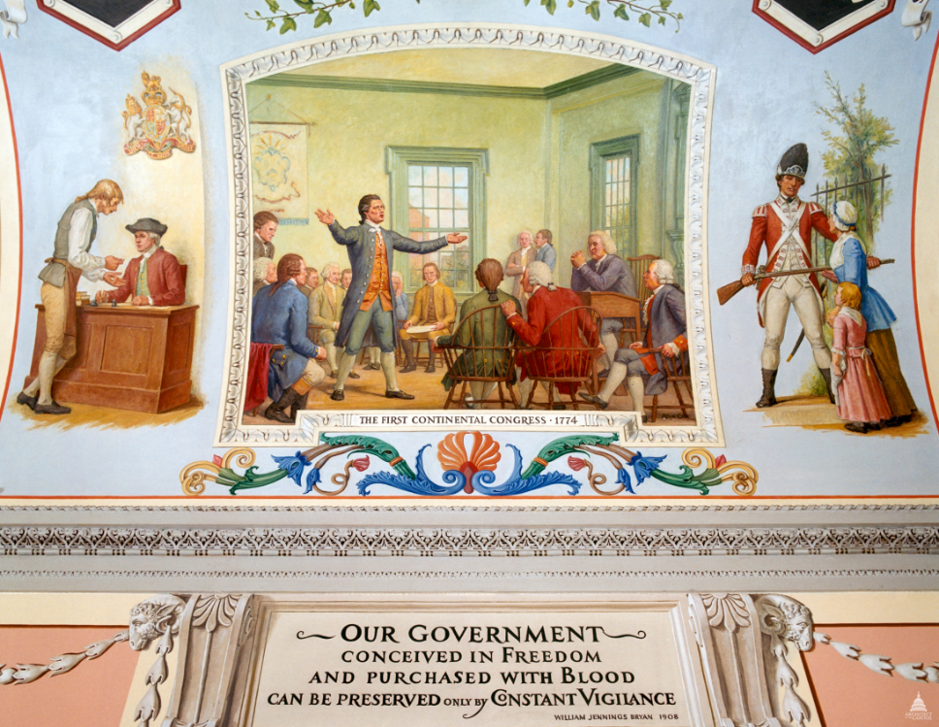
What was the colonies response to the Intolerable Acts?
Committees of Correspondence – Committees formed in Massachusetts and other colonies to keep Americans informed about British measures that would affect the colonies.
First Continental Congress (Philadelphia Sept. 1774) – 9 Colonies sent delegates…asked questions such as, why are soldiers pouring into Boston? Who are they protecting us from?
  Did the following:
    Issued Declaration and Resolves
    Created Committees of Observation and Safety
      Form Militia
      Collect Arms
      Create Minutemen

Slide 6
And Now For Something Completely Different

Slide 7
Patriots vs. Loyalists
Get out a sheet of paper
Create a T-chart on your paper
Label the left side:
Patriots
Label the right side:
Loyalists

Slide 8
Patriot vs. Loyalist Arguments
You will need to decide if the statement is a PATRIOT statement or a LOYALIST statement.
For each statement, record the underlined portion in your T-chart.

Slide 9
Statement 1
King George III is doing the best he can with a difficult situation. He is not a cruel or unjust ruler.

Slide 10
Statement 2
No one should have to pay a tax unless they choose the representative who helps determine that tax.

Slide 11
Statement 3
England has refused us our God-given rights.

Slide 12
Statement 4
Since England does not have the right to tax us, then they also do not have the right to make other laws that affect us.

Slide 13
Statement 5
We should pay our fair share to England. We have wealth, religious freedom, and opportunity for all. We are far better off than other countries.

Slide 14
Statement 6
We need the protection that England can give us. They protected us in the French and Indian war. They can also protect us in future conflicts.

Slide 15
Statement 7
England and the colonies all have the same roots. A war against England is like having a war against our own family.

Slide 16
Statement 8
Morally, we are better than England. We know the difference between right and wrong. England's government is corrupt.

Slide 17
Statement 9
The Boston Massacre was the result of irresponsible colonists not keeping their children under control

Slide 18
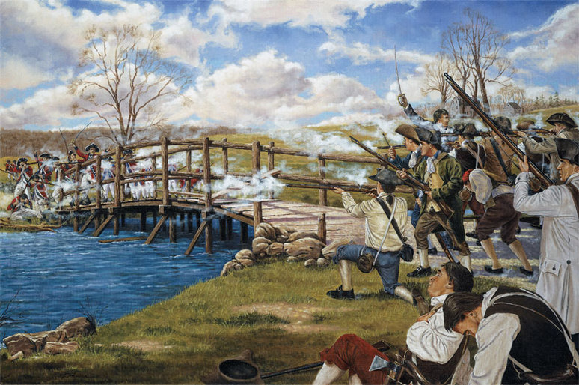
How does war finally begin?
“Gentlemen may cry peace, peace! But there is no peace. If life so dear, or peace so sweet, as to be purchased at the price of chains and slavery? Forbid it, Almighty God! I know not what course others may take, but as for me, give me liberty or give me death.” - Patrick Henry (March 1775)
1) Lexington and Concord: Detachment of British troops sent out from Boston to capture American arms at Concord.
* First contact and bloodshed at Lexington and
further on the British march back to Boston.
* 95 Minutemen casualties
* 275 British casualties (73 dead)
* Blood shed on both sides…hard to
reconcile from here forward.

Slide 19
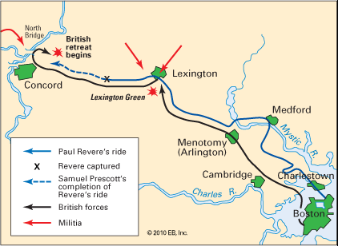

Slide 20
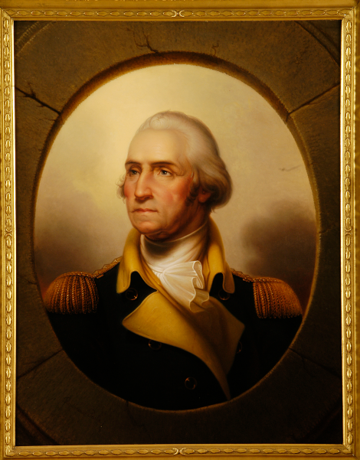
What was the importance of the 2nd Continental Congress? (May 1775)
First Issue: Defense of the Colonies.
George Washington elected Commander-in-chief of all Continental forces.
One more shot at RECONCILIATION:
* OLIVE BRANCH PETITION: Plea to the King to
listen to colonists grievances and avoid conflict. Also
professed their attachment to the king.

Slide 21
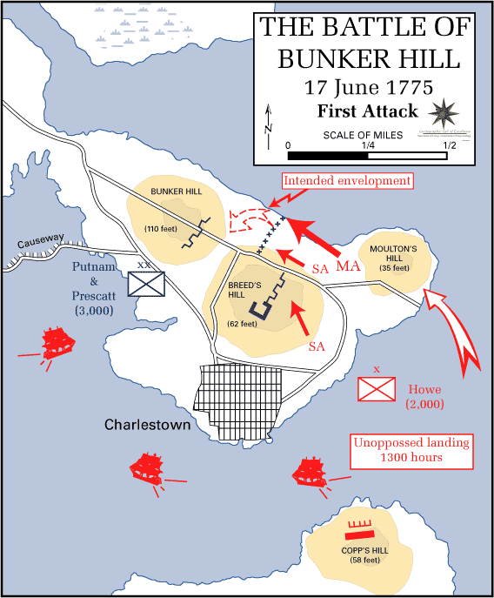
What was the impact of the Battle of Bunker Hill? (June 1775)
British victory but at a cost:
British = 1000 Casualties (226 KIA)
Colonists = 140 dead
English = no chance for a
peaceful solution now.
King George III rejects the
Olive Branch Petition in
August 1775.

Slide 22
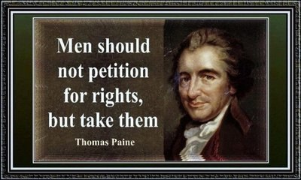
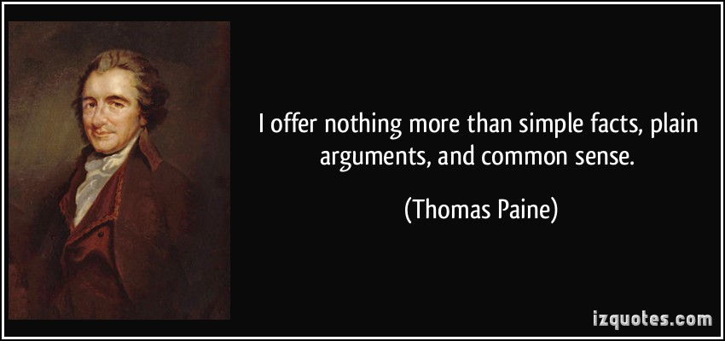
What was “Common Sense?” (Jan. 1776)
Pamphlet written by Thomas Paine urging colonists to push for Independence from the British.
“We have it in our power to begin the world over again. A situation, similar to the present, hath not happened since the days of Noah until now.” * Thomas Paine
It reshaped popular thinking and put INDEPENDENCE SQUARELY ON THE AGENDA.

Slide 23
What’s next?
Get out a sheet of paper
Write me a letter in which you tell me whether you’re a Patriot or Loyalist. You must provide a minimum of four reasons for your choice.
  Must relate to content we have covered thus far
The letter must be at least 1page.
This counts as a grade.
Each letter needs an intro, body, and conclusion.

