Slide 1

This stage involves recovering from the illness. The individual might
be weakened from the experience, but he or she will eventually
emerge healthy and with new knowledge and experience that might
prevent the illness from occurring again.
What would this stage be like in a revolution?
Crisis
Convalescence
Symptomatic
Recovery
Incubation
In a revolution, this stage would involve recovering from the extreme
disruptions of the crisis stage. In general, the political, social,
intellectual, or economic causes of the revolution must be addressed in
some way, though not necessarily to the satisfaction of all
revolutionaries.

Slide 2
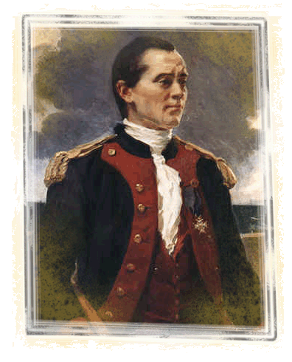
Battle of Yorktown—1781
French blockade aided
this final battle
Escape for the British was impossible
British General Cornwallis faced American forces approximately twice his size
John Paul Jones
Notes:
The end was in sight with the Battle of Yorktown. The Americans were aided by a French blockade making British escape impossible. British General Cornwallis faced American forces approximately twice his size and no where to go.

Slide 3
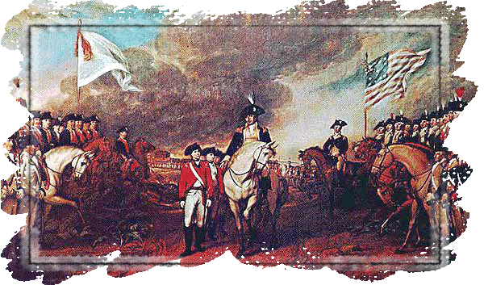
Yorktown
Approximately 8,700 British troops surrendered
Pinned in by
American and
French Naval
fleets
General Benjamin
Lincoln accepted
the surrender
sword
British bands played “The World has Turned Upside Down”
Notes:
The last campaign of the Revolution took place in the south at Yorktown, Virginia, in 1781. About 8,700 British troops surrendered when the Americans and the French naval fleet pinned in the British in a series of brilliant strategic maneuvers. General Benjamin Lincoln accepted the surrender sword from a Cornwallis aide. The British bands played “The World Turned Upside Down.”

Slide 4
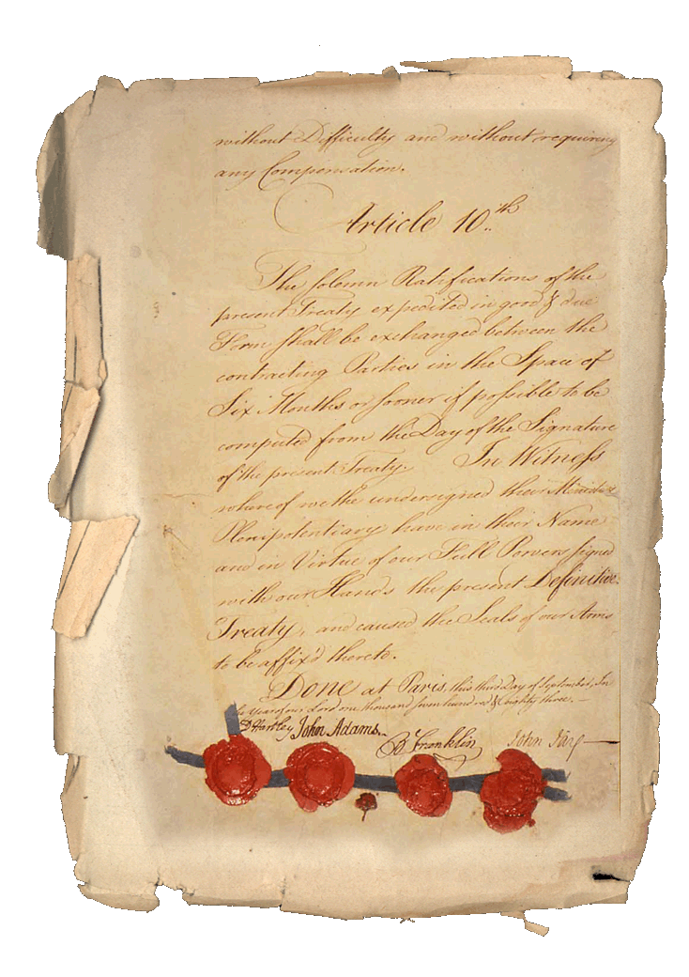
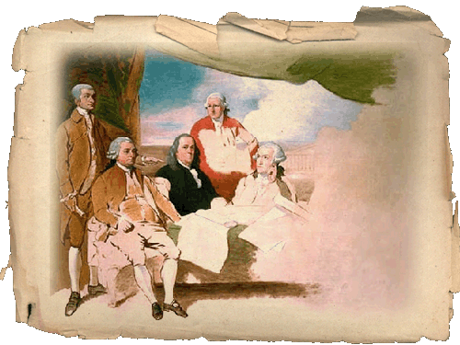
The Treaty of Paris
1783: The Treaty of Paris officially ends the Revolutionary War
Notes:
The Treaty of Paris in 1783 officially ended the American Revolution.

Slide 5
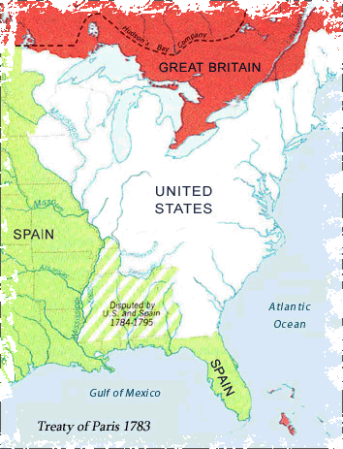
The Treaty of Paris—1783
Officially ended the American Revolution
Set many geographic borders, including U.S. and Canada
Florida was returned to Spain
Notes:
The official end to the war came two years after Yorktown at the Treaty of Paris. The British commander, Cornwallis, was so humiliated by the defeat that he refused to meet with Washington for the formal surrender and sent an aide instead. The treaty set many geographic borders including that of the United States and Canada. Canada went to the British, but later the French won part of the country. Florida was returned to Spain.

Slide 6
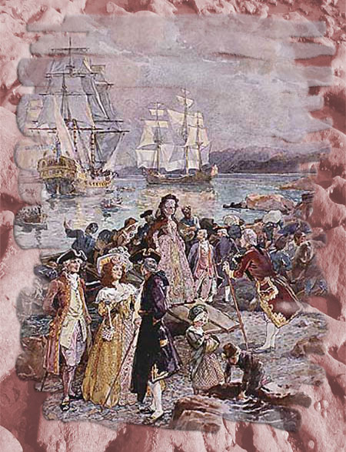
The Aftermath:
Penalties inflicted on Loyalists
Some Loyalists were “tarred and feathered” and put on ships bound for Canada or Great Britain
Notes:
Penalties awaited those who had been loyal to the king or who did not support the Revolutionaries’ cause. For example, some Loyalists were “tarred and feathered.” Ships waited in numerous harbors to transport Loyalists back to Great Britain or to Canada. Many descendants of former Loyalists reside in Canada today.

Slide 7
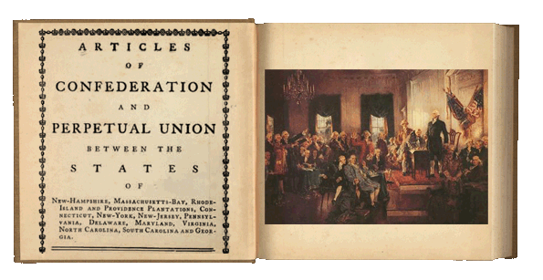
The Articles of Confederation
Written by John Dickson in 1777
Ratified in 1781
Governed Americans in 1781-1787
Paved way for new Constitution
Notes:
The country was in need of a new government and a written document to finalize it. The Articles of Confederation, written by John Dickinson in 1777 and ratified in 1781, served as America’s primary government between 1781-1787. Americans created a “more perfect union” with the creation of the United States Constitution.

Slide 8

Articles of Confederation Video
Single click screen
to view video:
Notes:
This video clip examines the effectiveness of The Articles of Confederation.

Slide 9
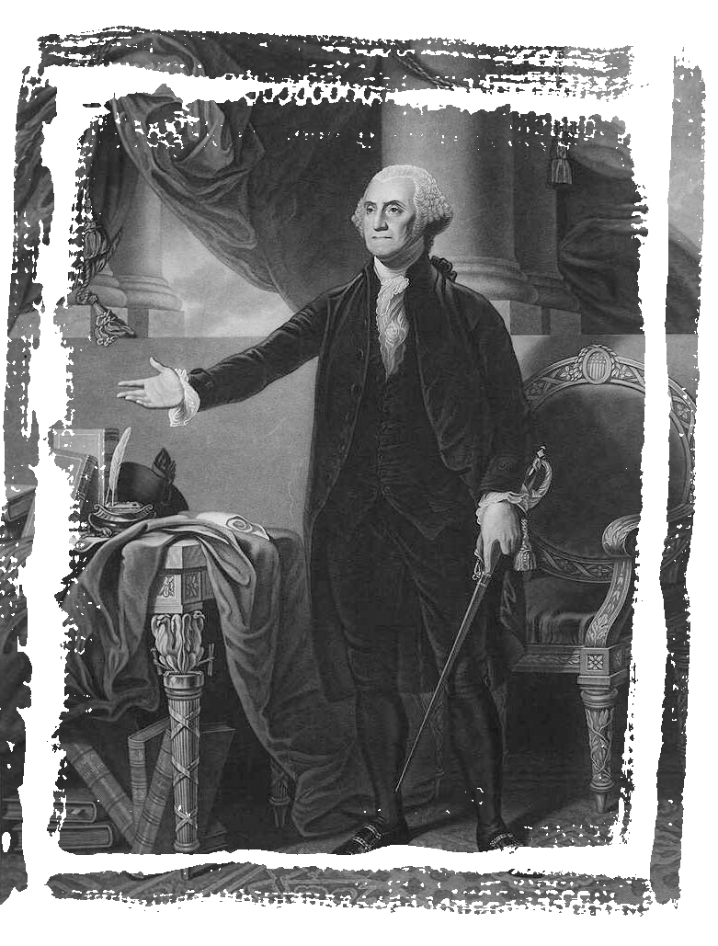
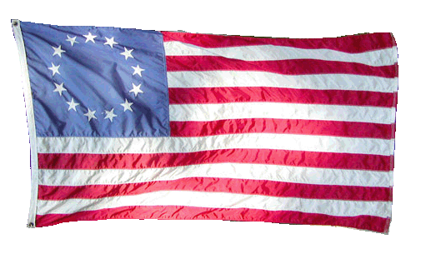
Concluding Thoughts
Eight years
Timeless impact
Subject of countless plays and films
Maker of heroes
Birth of a nation
Notes:
America was officially here to stay. The American Revolution was an eight-year struggle, but the outcome of the struggle would forever change the world. Its events are the subject of countless plays and films. On the battlefields, and in the meeting houses, lives were lost and heroes were made. More importantly, the Revolution led to the birth of a nation unlike any the world had seen before it.

