Slide 1
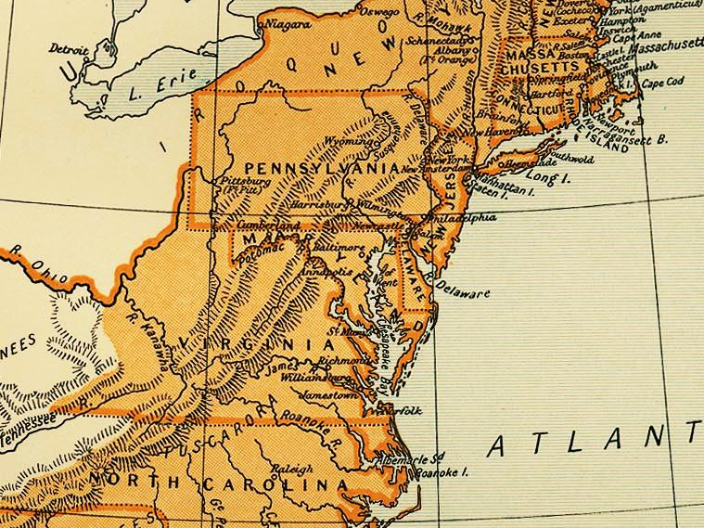
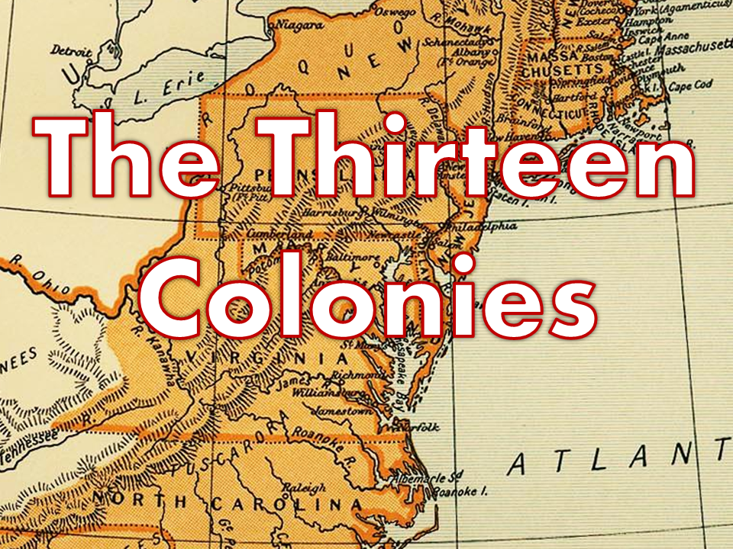


The Thirteen
Colonies
USHC 1.1
Summarize the distinct characteristics of each colonial region in the settlement and development of British North America, including religious, social, political, and economic differences.

Slide 2
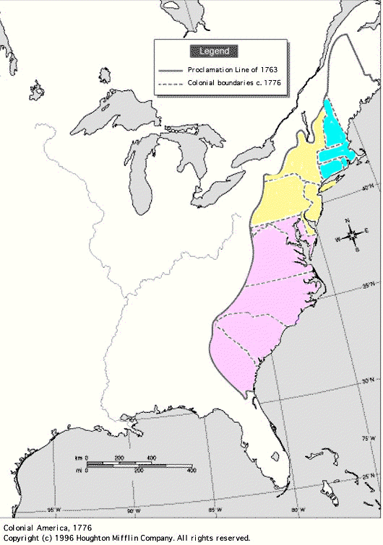
Key Colonies
NEW ENGLAND
  Massachusetts
  Rhode Island
MIDDLE
  New York
  Pennsylvania
SOUTHERN
  Maryland
  Virginia
  Carolina
  Georgia

Slide 3
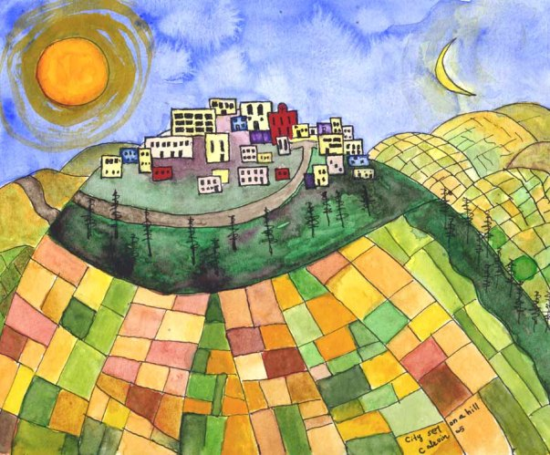

Slide 4
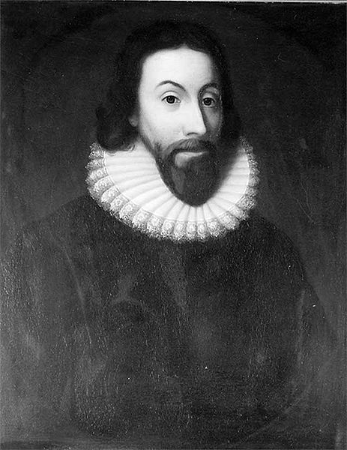


Massachusetts Bay Colony
Religious Dissidents
  Puritans and Separatists
City on
a Hill!
http://www.craigirvin.com/watermedia.htm
John Winthrop Governor

Slide 5
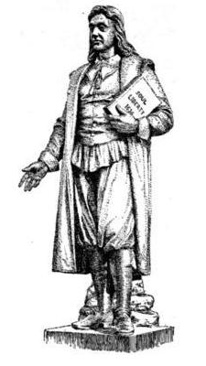

Religious Dissenters
Religious “Freedom” vs. Religious Toleration
Roger Williams
  Puritan Minister
  Liberty of Conscience
  Established Religion
  EXILED
  Providence Plantations
    (Rhode Island)
  First Baptist Church USA
Williams

Slide 6
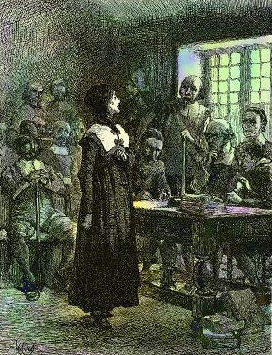
Religious Dissenters
Religious “Freedom” vs. Religious Toleration
Anne Hutchinson
  Home Bible Studies
  Predestination
    The Elect
  EXILED
    13 children
    60 followers
  Killed by Indians

Slide 7
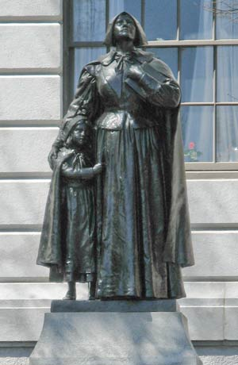
Anne Hutchinson Memorial
Massachusetts State House

Slide 8
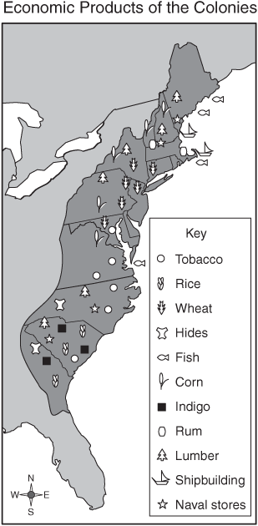
The Colonial Economy

Slide 9
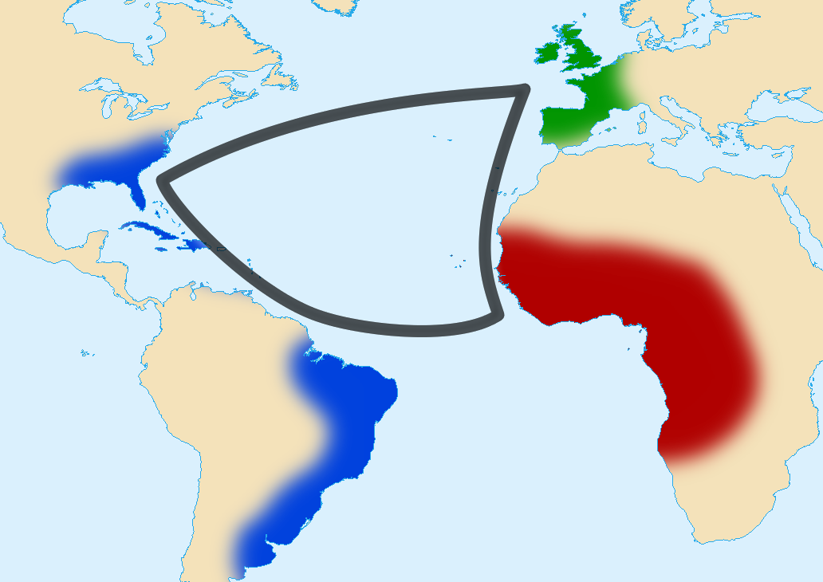
The Triangular Trade
RAW GOODS
FINISHED GOODS
SLAVES

Slide 10
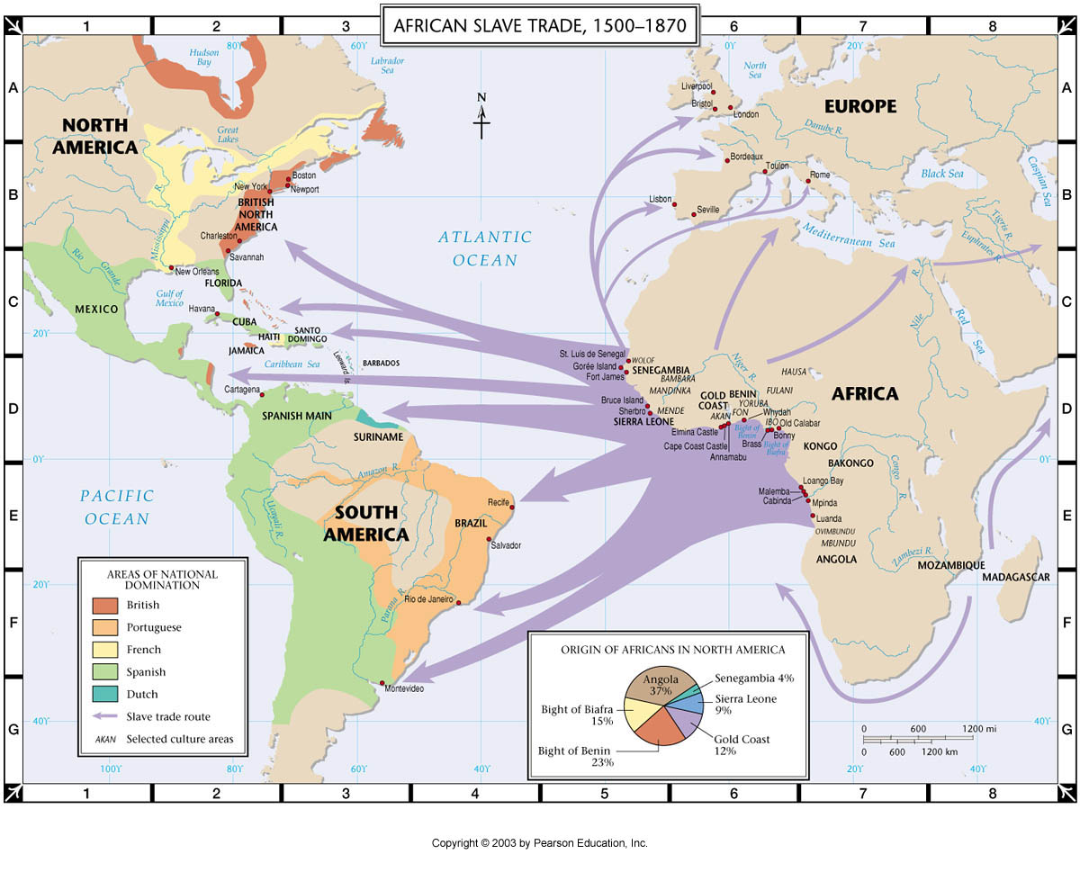

Slide 11
Economic Map: New England
What were the primary economic activities in the New England colonies?
COMMERCE
FISHING
SHIPPING
DISTILLING RUM
TIMBER

Slide 12
GRAPHIC ORGANIZER 1.3
 | NEW ENGLAND COLONIES | MIDDLE COLONIES | SOUTHERN COLONIES
KEY COLONIES | Massachusetts Rhode Island
KEY FIGURES | John Winthrop Roger Williams Anne Hutchinson
WHY SETTLE? | Commerce “Religious Freedom”
ECONOMIC ACTIVITIES | Fishing, Shipbuilding, Timber, Distilling Rum
PREDOMINANT RELIGION(S) | Calvinists (Puritans/Separatists) Baptists (RI)
RELIGIOUS OUTLOOK | Fanatical

Slide 13
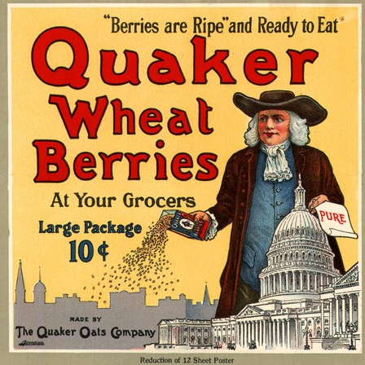
Pennsylvania
William Penn
  Society of Friends
    aka: “Quakers”
“Penn’s Woods”
  Philadelphia
TOLERATION
Indian Treaty

Slide 14
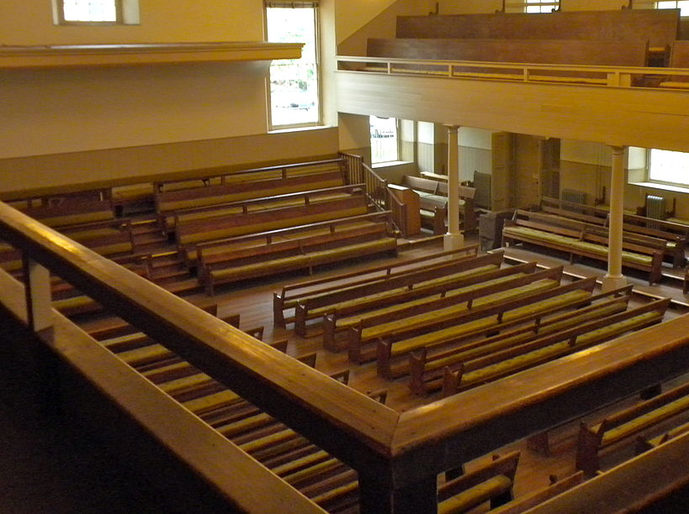
A Quaker Meeting House

Slide 15
Quakers vs. Church of England
QUAKERS | CHURCH OF ENGLAND
Baptism | Baptism
Communion | Communion
Clergy | Clergy
Women Speak | Women Speak
Pacifist | War OK

Slide 16
Economic Map: Middle Colonies
What were the primary economic activities in the Middle colonies?
STAPLE CROPS
(Breadbasket)

Slide 17
GRAPHIC ORGANIZER 1.3
 | NEW ENGLAND | MIDDLE COLONIES
KEY COLONIES | Massachusetts, Rhode Island | New York, Pennsylvania
KEY FIGURES | Roger Williams, Anne Hutchinson, Jonathan Edwards | William Penn
WHY SETTLE? | Commerce “Religious Freedom” | AGRICULTURE (Staple Crops) Religious Toleration Ship Building
ECONOMIC ACTIVITIES | Fishing, Shipbuilding, Timber, Distilling Rum | STAPLE CROPS (Wheat, Corn)
PREDOMINANT RELIGION(S) | Congregational (Puritan) Baptists (RI) | Church of England (NY) Quakers (PA)
RELIGIOUS OUTLOOK | Fanatical | Tolerant

Slide 18
Economic Map: Southern Colonies
What were the primary economic activities in the Southern colonies?
CASH CROPS

Slide 19
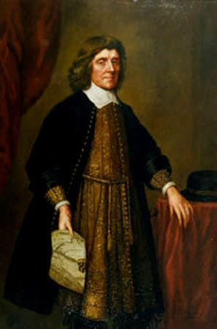
Maryland
Lord Baltimore
Haven for Catholics
Maryland Toleration Act
  Toleration for all Trinitarian Christians
  Outright heresy = death

Slide 20
Tensions in the Colonies
BACON’S REBELLION Virginia, 1676 | STONO REBELLION South Carolina, 1739
Disgruntled White Rebellion | Slave Rebellion
Frontier vs. Tidewater (Frustration over royal governor’s lack of response to Indian attacks) | 20 whites / 44 slaves killed (Rebel slaves beheaded a white shopkeeper – captured slaves’ heads were publicly displayed on poles in response)
Royal Governor relieved of duty | Tighter controls over slavery passed by legislature

Slide 21
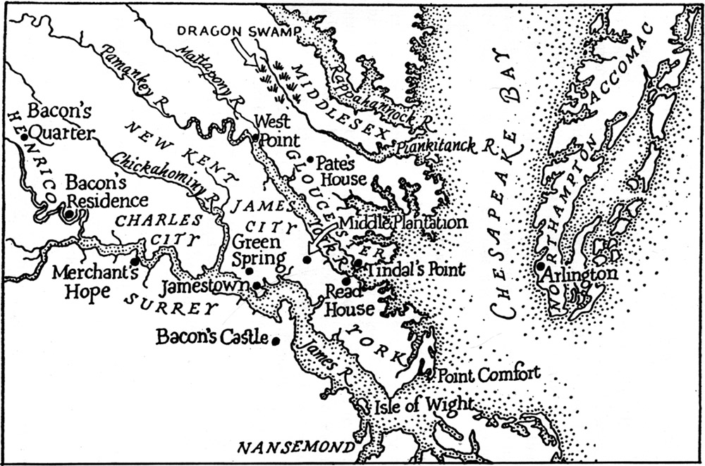
From Wertenbaker, Thomas Jefferson, Torchbearer of the Revolution
Map of Virginia at the time of Bacon's Rebellion

Slide 22

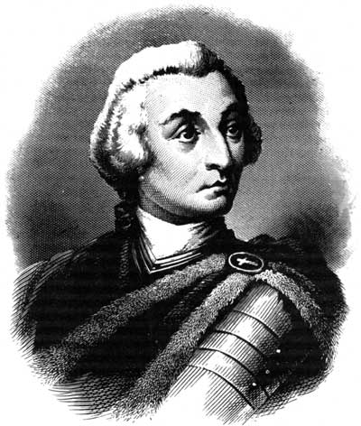
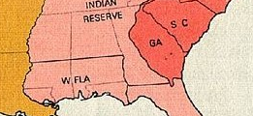
Georgia
James Oglethorpe
  General
  Philanthropist
Penal Colony
Buffer Colony

Slide 23
GRAPHIC ORGANIZER 1.3
 | NEW ENGLAND COLONIES | MIDDLE COLONIES | SOUTHERN COLONIES
KEY COLONIES | Massachusetts, Rhode Island | New York, Pennsylvania | Maryland, Virginia, Carolina, Georgia
KEY FIGURES | Roger Williams, Anne Hutchinson, Jonathan Edwards | William Penn | John Smith, John Rolfe, Lord Baltimore, James Oglethorpe
WHY SETTLE? | Commerce “Religious Freedom” | AGRICULTURE (Staple Crops) Religious Toleration | AGRICULTURE (Cash Crops)
ECONOMIC ACTIVITIES | COMMERCE Fishing, Shipbuilding, Timber, Distilling Rum | STAPLE CROPS (Wheat, Corn) | CASH CROPS (Tobacco, Rice, Indigo)
PREDOMINANT RELIGION(S) | Congregational (Puritan) Baptists (RI) | Church of England (NY) Quakers (PA) | Church of England (Established) Catholic (Maryland)
RELIGIOUS OUTLOOK | Fanatical | Tolerant | Casual

Slide 24

Mercantilism
Exports > Imports
Economic Nationalism
  Colonies trade with mother country
REGULATION OF TRADE
  Navigation Acts (1651)
    SALUTARY NEGLECT
      Trade laws weren’t
      strictly enforced

Slide 25
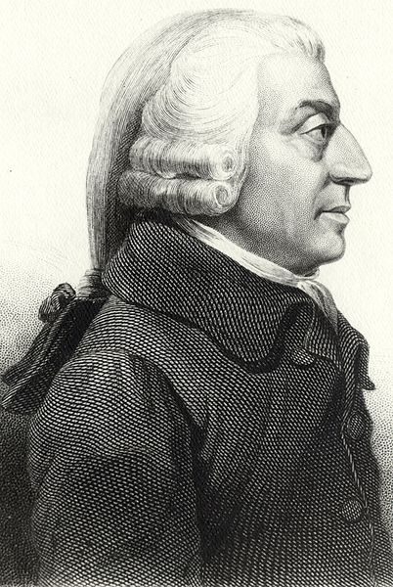
Wealth of Nations
Adam Smith
  Philosopher
  Economist
Wealth of Nations (1776)
Laissez-faire (let it be)
  Nations would be wealthier if governments limited their involvement in the economy and allowed free trade.

Slide 26
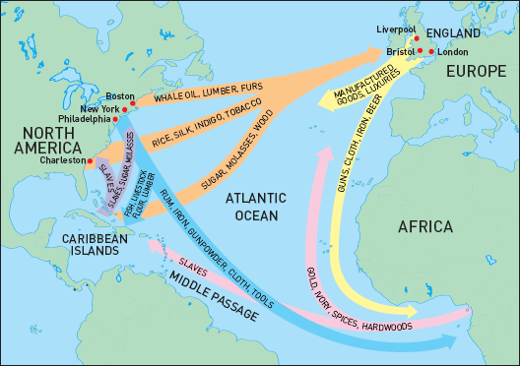
Colonial Trade Routes
INTERACTIVE MAP

Slide 27








